Slide 1
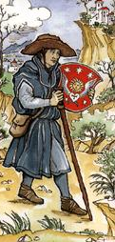
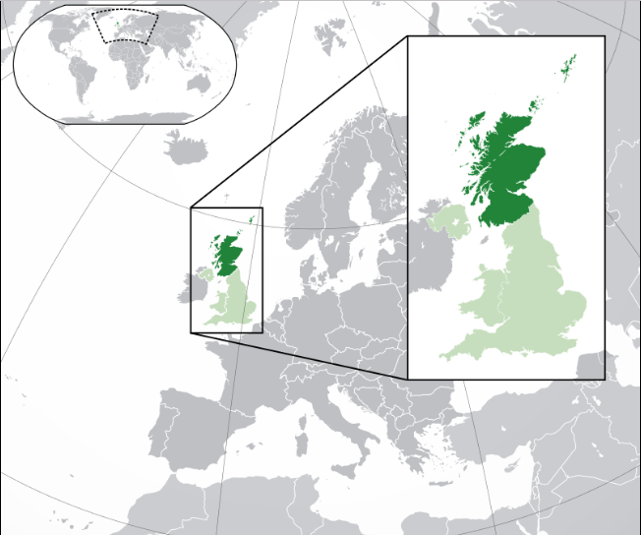
Reformation In Scotland
Source: Wikipedia graphics
See More At http://www.TheRestorationMovement.com/

Slide 2
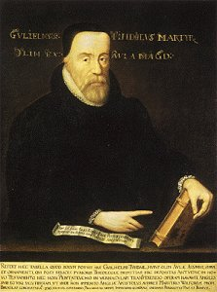
Early Plantings Of Reform In Scotland
By 1530 – Tyndale’s English Translation of 1525 Was Being Widely Used In Scotland
See More At http://www.TheRestorationMovement.com/

Slide 3
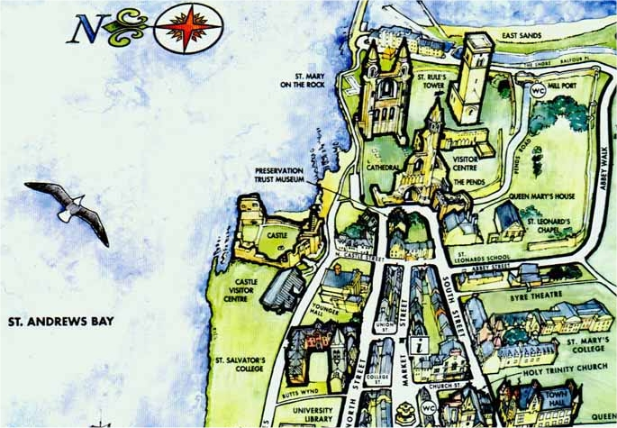
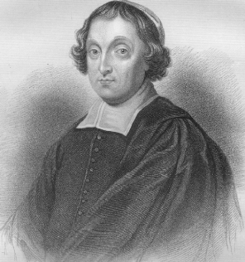
St. Andrews, Fife, Scotland
Cardinal David Beaton 1494-1548
See More At http://www.TheRestorationMovement.com/

Slide 4
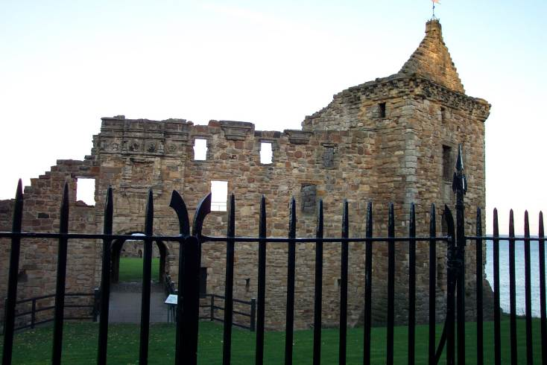
The Bishop’s Castle Of St. Andrews
These are ruins of the second castle, the first of which was destroyed during the wars of independence from 1400 to 1560.
During the Protestant Reformation, the forces of John Knox overtook the forces of Cardinal Beaton in late 1546
See More At http://www.TheRestorationMovement.com/

Slide 5
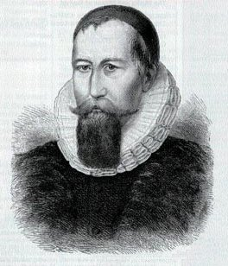
Early Reformers In Scotland
Patrick Hamilton
1504-1528
See More At http://www.TheRestorationMovement.com/

Slide 6
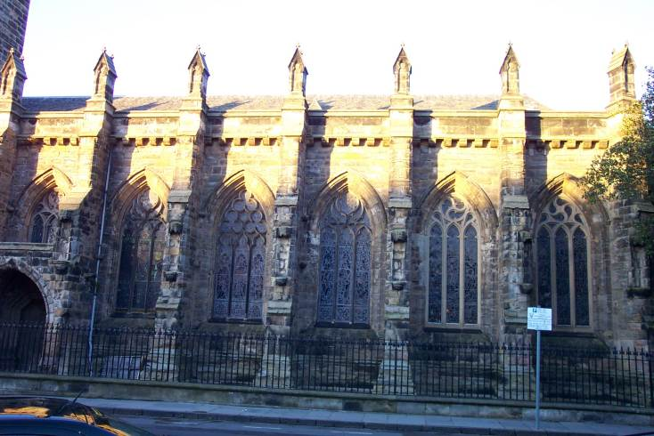
The St. Andrews Church
See More At http://www.TheRestorationMovement.com/

Slide 7
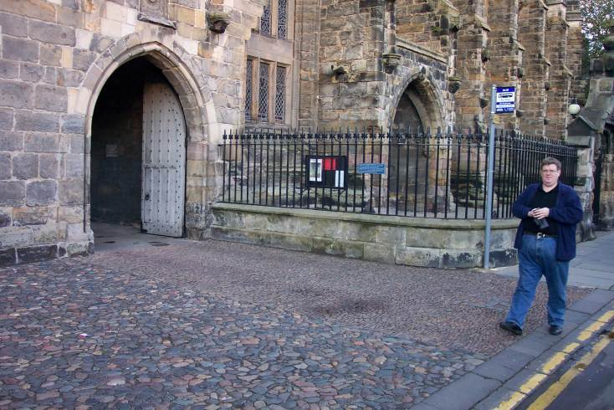
The Death Of Patrick Hamilton
See More At http://www.TheRestorationMovement.com/

Slide 8
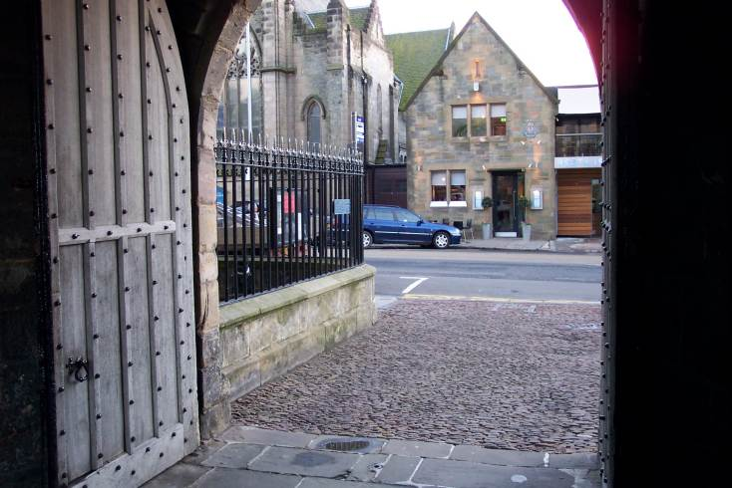
The Death Of Patrick Hamilton
A Marker Still Shows The Spot Where Hamilton Died
See More At http://www.TheRestorationMovement.com/

Slide 9
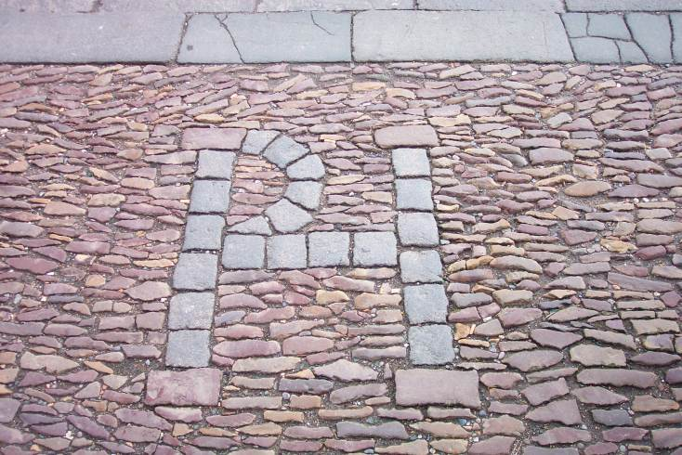
The Death Of Patrick Hamilton
See More At http://www.TheRestorationMovement.com/

Slide 10
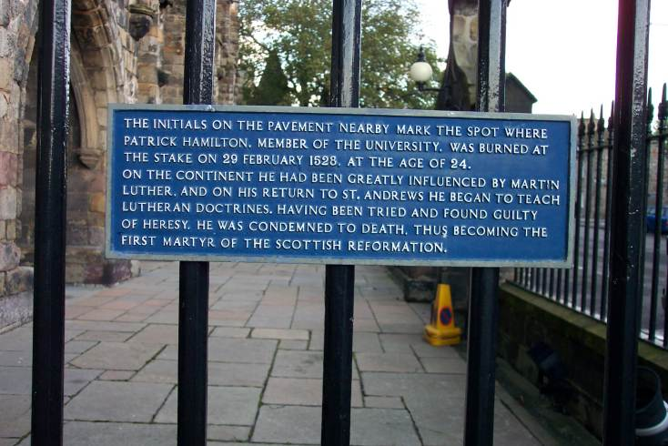
The Death Of Patrick Hamilton
See More At http://www.TheRestorationMovement.com/

Slide 11
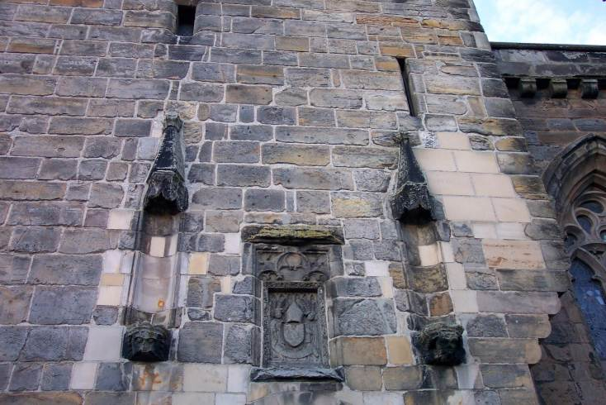
The Death Of Patrick Hamilton
The Heat Of The Fire That Burned Hamilton Was Said To Be So Hot That It Permanently Burned His Face Into The Stone Of The Church That Stood Closeby
See More At http://www.TheRestorationMovement.com/

Slide 12
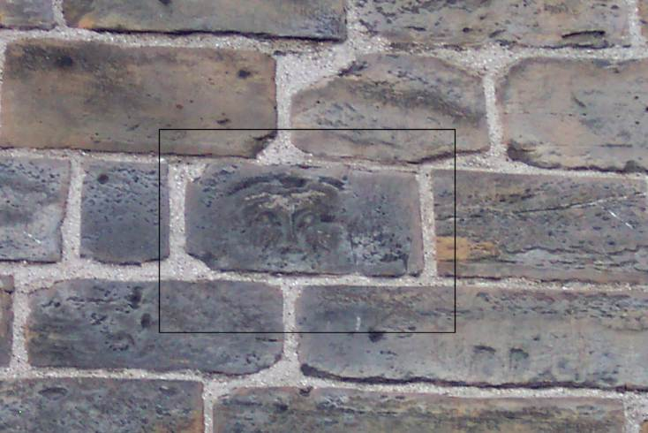
The Death Of Patrick Hamilton
See More At http://www.TheRestorationMovement.com/

Slide 13
George Wishart 1513-1546
See More At http://www.TheRestorationMovement.com/

Slide 14
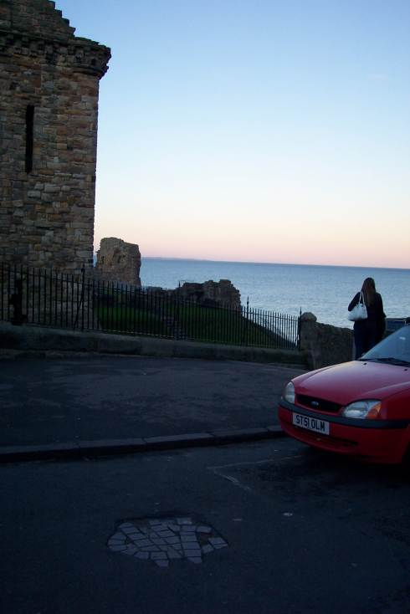
The Demise of George Wishart
See More At http://www.TheRestorationMovement.com/

Slide 15
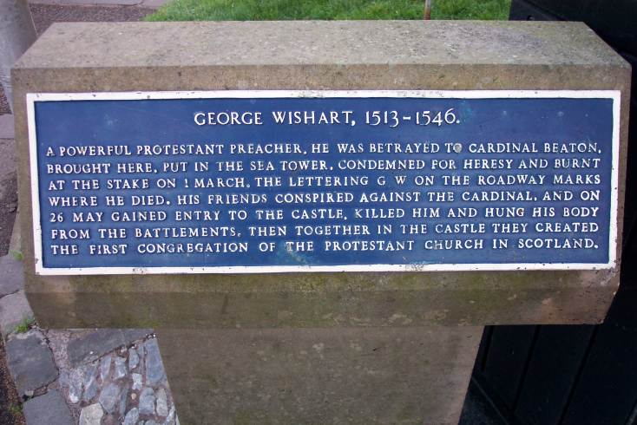
The Death Of George Wishart
See More At http://www.TheRestorationMovement.com/

Slide 16
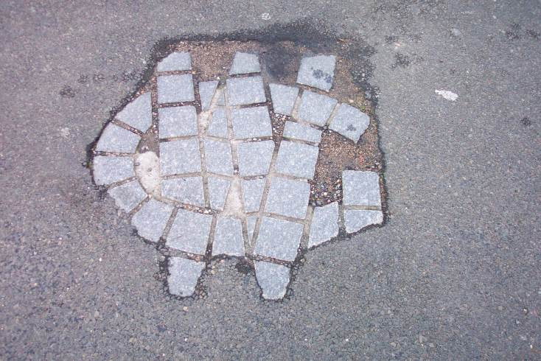
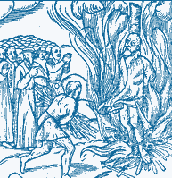
The Death Of George Wishart
Burning Religious Leaders At The Stake Only Fueled The Fire Of The Spirit Of Reformation In Scotland As In All Of Europe
See More At http://www.TheRestorationMovement.com/

Slide 17
Scottish Catholicism: Contributing Factors Bringing About Reform
Graphic source: wikipedia.com
Cardinal David Beaton Archbishop Of St. Andrews Church, Scotland 1494-1546
Graphic source: wikipedia.com
See More At http://www.TheRestorationMovement.com/

Slide 18
John Knox 1505-1572
Graphic source: wikipedia.com
Graphic source: wikipedia.com
See More At http://www.TheRestorationMovement.com/

Slide 19
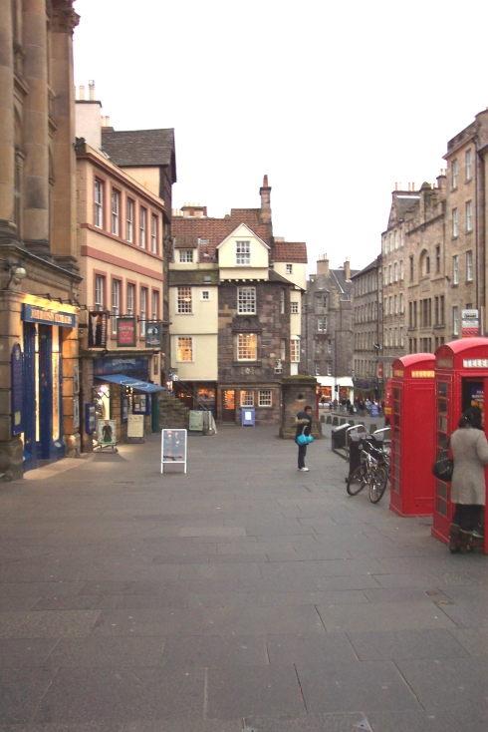
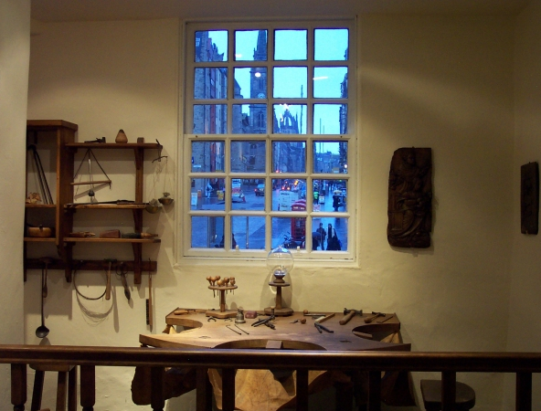
John Knox Home In Edinburgh
See More At http://www.TheRestorationMovement.com/

Slide 20
Knox & The Church Of Scotland
See More At http://www.TheRestorationMovement.com/

Slide 21
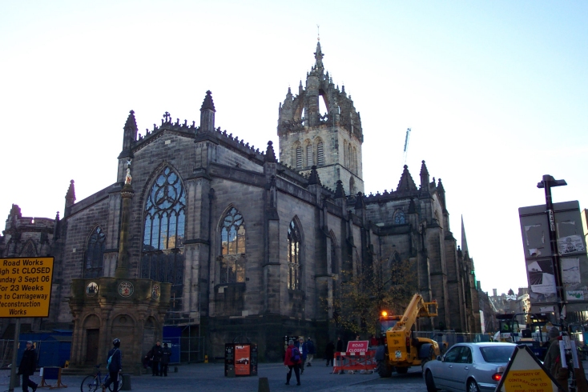
St. Giles Church: Home Of The Church Of Scotland
See More At http://www.TheRestorationMovement.com/

Slide 22
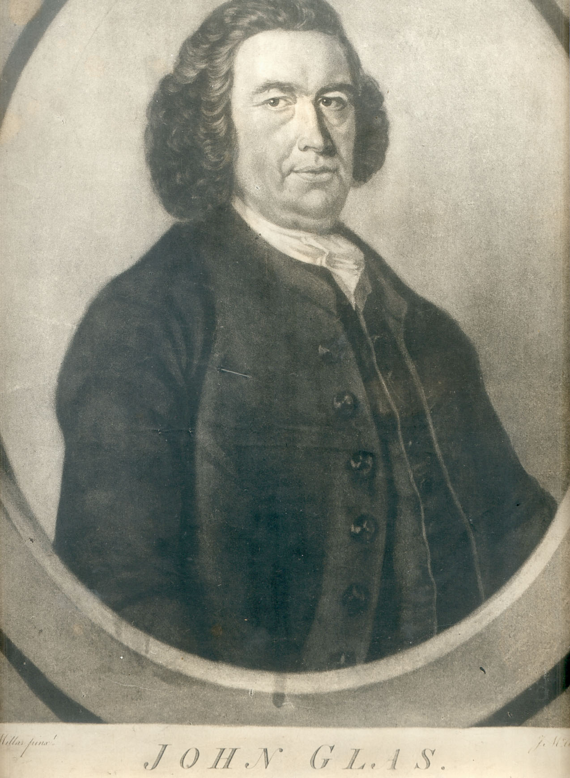
John Glas 1695-1773
See More At http://www.TheRestorationMovement.com/

Slide 23
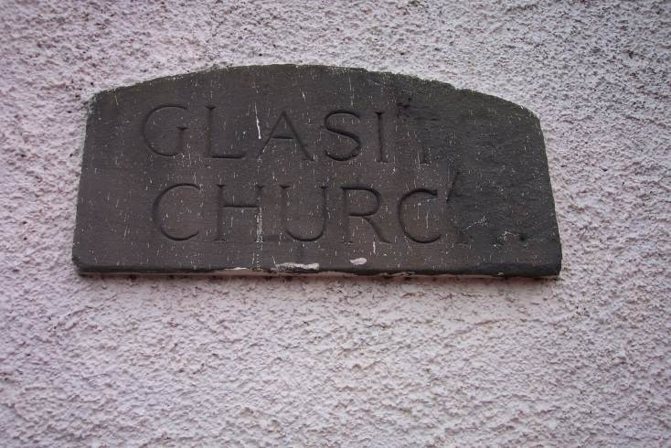
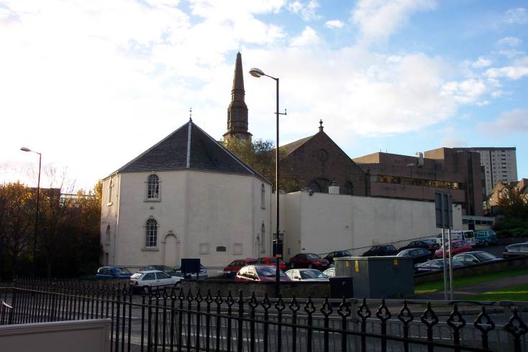
Glasite Church - Dundee
See More At http://www.TheRestorationMovement.com/

Slide 24
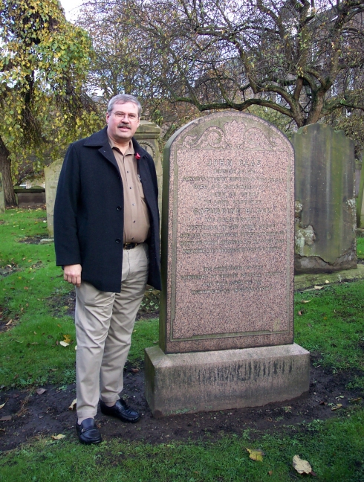
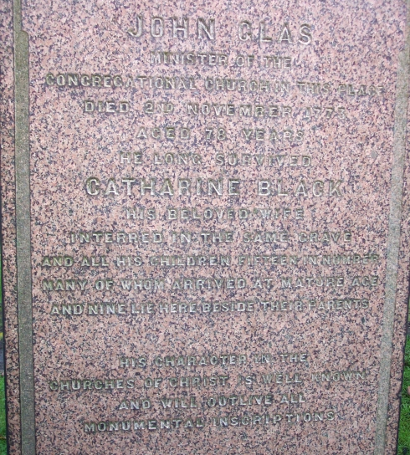
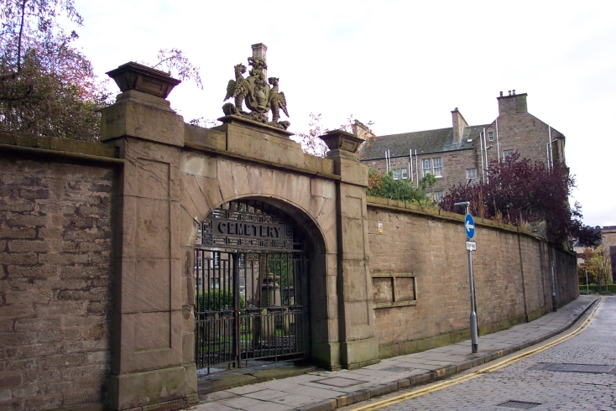
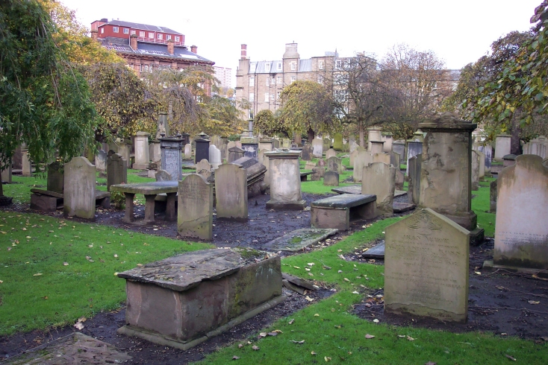
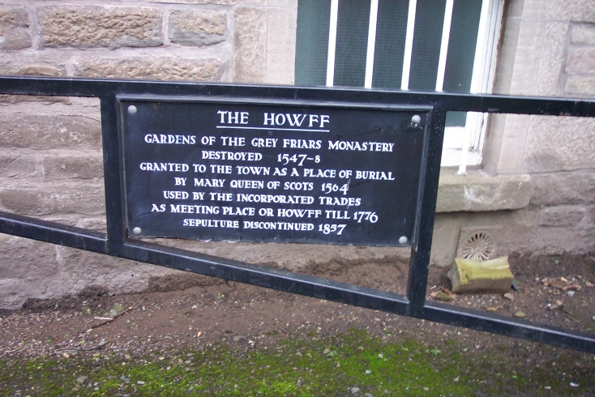
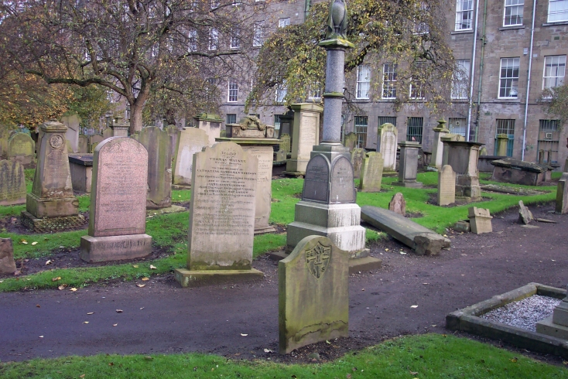
John Glas – Buried In Howff
See More At http://www.TheRestorationMovement.com/

Slide 25
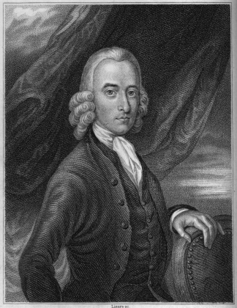
Robert Sandeman 1718-1771
See More At http://www.TheRestorationMovement.com/

Slide 26
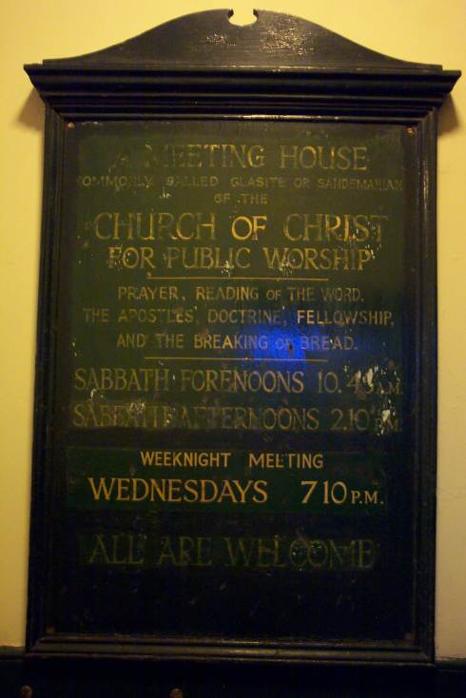
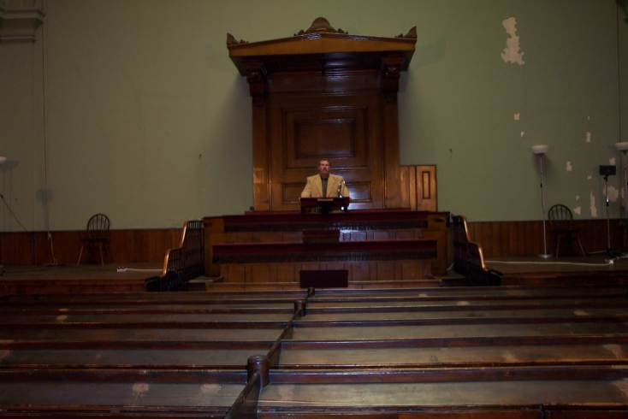
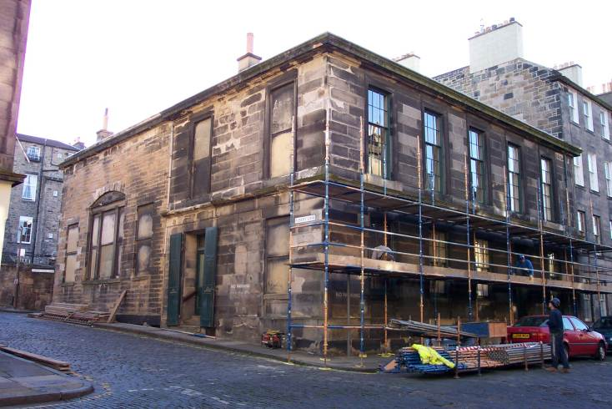
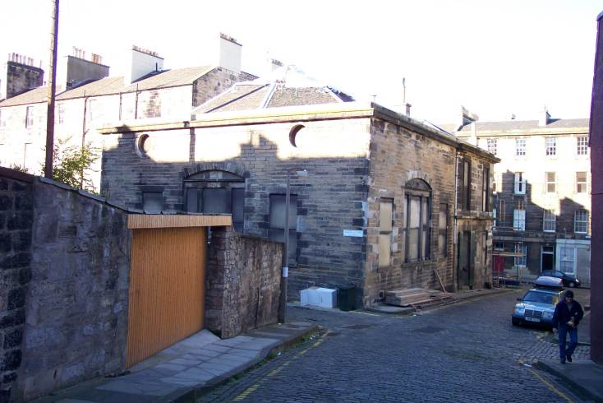
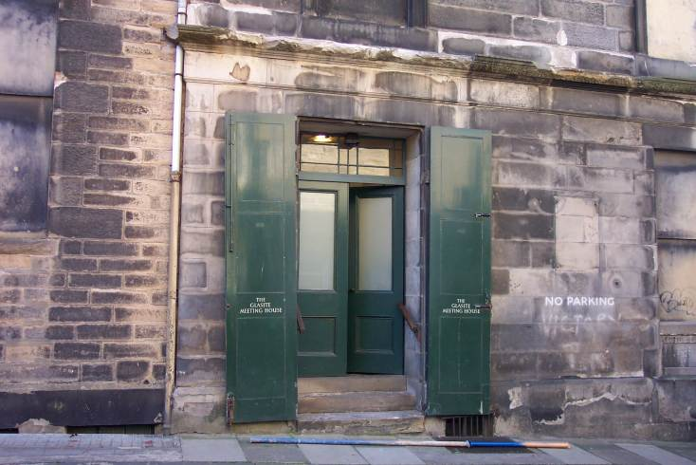
Glasite Church In Edinburgh
See More At http://www.TheRestorationMovement.com/

Slide 27
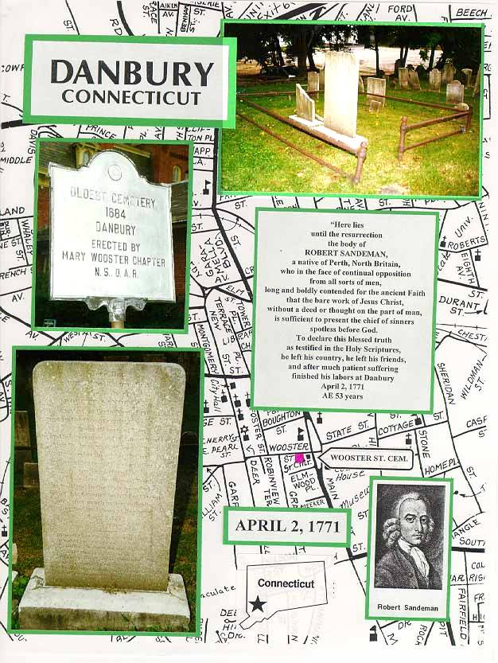
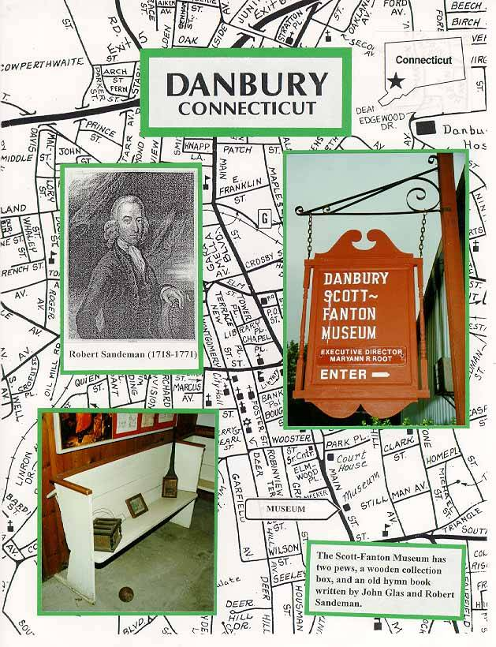
Robert Sandeman, Danbury, Conn.
See More At http://www.TheRestorationMovement.com/

Slide 28
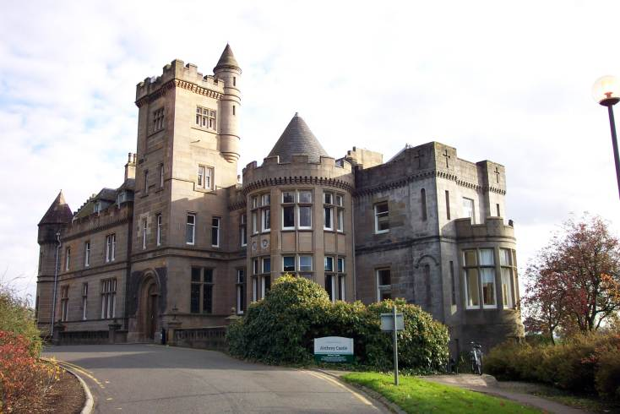
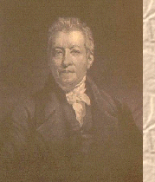
Robert & James Haldane - Airthrey Castle, Sterling -
James Haldane 1768-1851
See More At http://www.TheRestorationMovement.com/

Slide 29
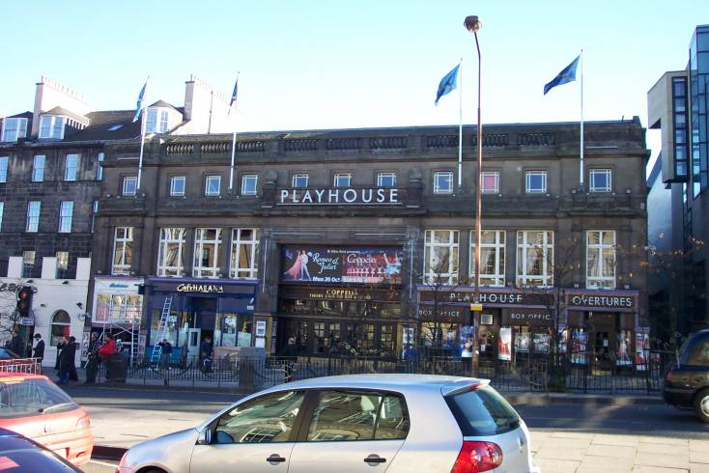
Haldane Tabernacle - Edinburgh
See More At http://www.TheRestorationMovement.com/

Slide 30
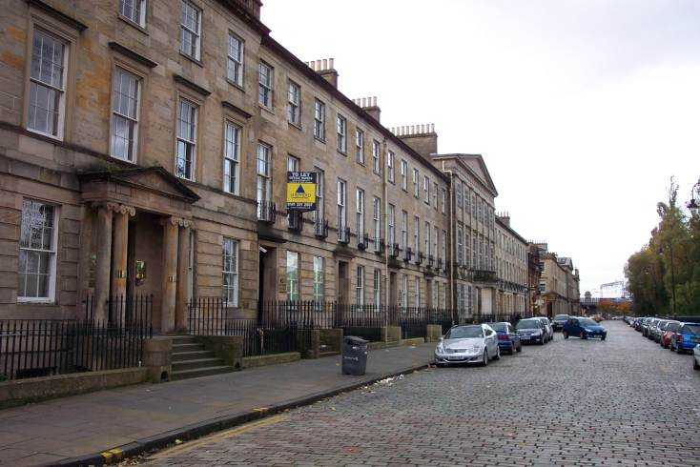
Greville Ewing
1767-1841
Street Where Ewing Lived In Glasgow Facing The River Clyde
See More At http://www.TheRestorationMovement.com/

